Slide 1

Data Interpretation

Slide 2
Formulae:
Average = Sum of Values / No.of Values
Percentage = (Given Value/Total Value)*100
Part = Given Value/Total Value
By what % the value is less/more than the given value = (difference between values/initial value ) *100
Ratio = comparison

Slide 3
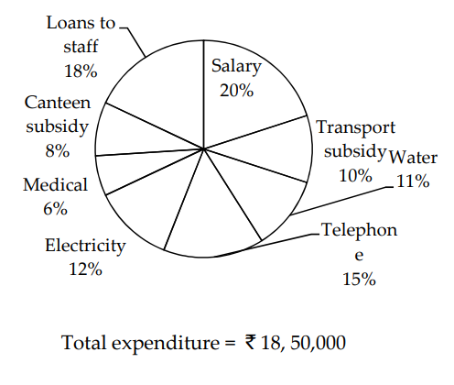
What is the amount spent on transport subsidy and canteen subsidy together?
1) ` 334000 2) ` 343000 3) ` 330000 4) ` 333000 5) None of these

Slide 4
What is the difference between the expenditure on salary and that on loans to staff?
1) ` 37200 2) ` 35700 3) ` 37500 4) ` 35000 5) None of these

Slide 5
The amount spent on medical is what per cent of the amount spent on salary?
1) 30% 2) 33% 3) 25% 4) 22% 5) None of these

Slide 6
What is the amount spent on telephone?
1) ` 275500 2) ` 270500 3) ` 277500 4) ` 277000 5) None of these

Slide 7
What is the total expenditure on electricity and water together?
1) ` 425000 2) ` 425500 3) ` 422500 4) ` 425800 5) None of these

Slide 8
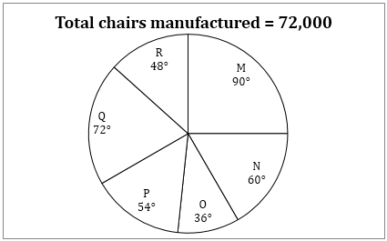
Find the total number of chairs manufactured by companies M, N and P together.
(a) 48,000
(b) 40,800
(c) 44,800
(d) 38,400
(e) 40,400

Slide 9
What is the ratio of number of chairs manufactured by O and R together to that of N and Q together ?
(a) 7: 11
(b) 11: 7
(c) 5: 11
(d) 11: 5
(e) 11: 12

Slide 10
If 33 ⅓% chairs of M and 16 ⅔% chairs of P are defective, then find the good chairs manufactured by these two companies.
(a) 23,000
(b) 24,000
(c) 21,000
(d) 21,500
(e) 22,400

Slide 11
What is the difference between chairs produced by Q and R?
(a) 4200
(b) 5000
(c) 4400
(d) 4800
(e) 3600

Slide 12
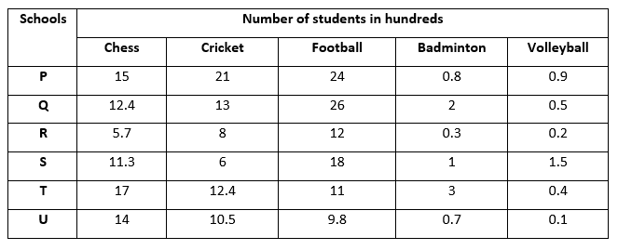
What is the average number of participants in football?
(a) 1675
(b) 1680
(c) 1600
(d) 1690
(e) 1569

Slide 13
By approximately what percent is the number of all Badminton participants less than those in Cricket?
a) 88% (b) 90% (c) 86% (d) 89% (e) 87%

Slide 14
What is the percentage (approximate) of total number of participating students in Volleyball over chess?
(a) 8%
(b) 5%
(c) 7%
(d) 9%
(e) 4%

Slide 15
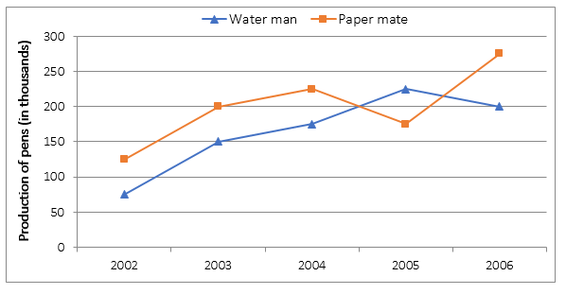
What is the ratio of Water man pens sold in the years 2002 and 2004 together to Paper mate pens sold in same two years together?
(a) 7 : 5
(b) 5 : 7
(c) 3 : 5
(d) 5 : 3
(e) 4: 7

Slide 16
What is the average production of Water man pens over all the years?
(a) 165 thousand
(b) 170 thousand
(c) 185 thousand
(d) 155 thousand
(e) 210 thousand

Slide 17
The number of Paper mate pens sold in the year 2005 is approximately what percent more or less than the number of Water man pens sold in the same year?
(a) 24%
(b) 25%
(c) 22%
(d) 20%
(e) 21%

